Slide 1
Bellringer
Review HW with your partner
You own a pizzeria. You have one oven in your kitchen. You can either make 2 pizzas or 4 calzones at one time. What is your opportunity cost if you make:
2 pizzas?
1 pizza?
4 calzones?

Slide 2
Agenda
Bellringer/Review HW
Review Questions…..
Notes: Production Possibility Curves

Slide 3
Review
What is scarcity?
Limited resources for unlimited wants
What are the factors of production?
Land, labor, capital, entrepreneur
What are the three types of capital?
Physical, human, financial
What is the difference between a trade off and an opportunity cost?
Trade off: decision; Opportunity cost: what is given up

Slide 4
Production Possibilities Curve

Slide 5
Connecting dots….
All resources are scarce
An economist studies the issue of scarcity
Because everything is scarce, you can’t have everything. You must give stuff up (opportunity cost and trade off)
Production possibilities curve helps you to determine the perfect balance between giving up and producing….

Slide 6
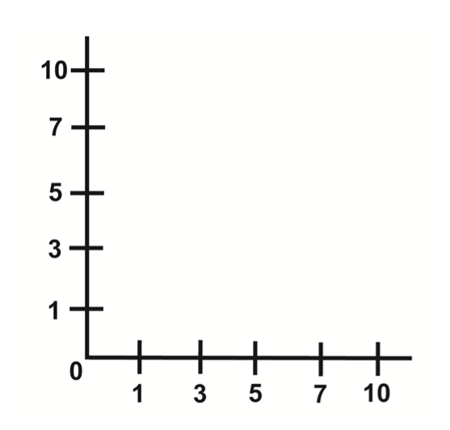
Production possibilities curve
Gallons of Milk | Blocks of Cheese
9 | 0
7 | 1
6 | 3
5 | 5
3 | 6
0 | 7

Slide 7
How does the curve show opportunity cost?
Opportunity Cost
Milk
Maximum efficiency! Be on the curve!
Cheese

Slide 8
The Curve…
Opportunity Cost
Milk
Underutilization (inefficiency): Using too few resources. Results in layoffs, recessions, misuse of natural resources, etc…
Cheese

Slide 9
The Curve…
Opportunity Cost
Milk
NOT POSSIBLE!! Only if new technology is introduced or new resources are found!
Cheese

Slide 10
The Curve…
Opportunity Cost
Milk
Underutilization/Inefficiency
NOT POSSIBLE!! Only if new technology is introduced or new resources are found!
Efficiency
Cheese

Slide 11
Economic Growth
Economic Growth! When the curve shows an outward movement that means that something happened to increase your production possibilities (ex: new technology or resources)
Milk
Cheese

Slide 12
Economic Decline
Economic Decline! When the curve shows an inward movement that means that something happened to decrease your production possibilities (ex: employees on strike)
Milk
Cheese

Slide 13
Practice
You have started a paper writing business. Write this data down and compose a production possibilities curve:
10 page research papers | 5 page research papers
18 | 0
15 | 1
12 | 3
9 | 9
5 | 15
3 | 19
0 | 22
Label the following: Both Axis, underutilization, efficiency, and impossibility
Draw the curve again and show economic growth (label) and economic decline (label)

Slide 14
Practice
On your own, try to answer the questions on the “Production Possibilities Frontier Worksheet”
FYI: Frontier is the same as curve

Slide 15
Vocab flash cards….
good,
service,
need,
want,
producer,
distributor,
scarcity,
shortage,
opportunity cost,
trade-off, and
factors of production.

