Slide 1
Period 3 Review
1815-1914

Slide 2
THE INDUSTRIAL REVOLUTION AGE OF ISMS REALISM ROMANTICISM REVOLUTIONS OF 1820S-1830S

Slide 3
Events leading up to IR
Commercial Revolution (1500-1800)
Age of Exploration
Price Revolution
Capitalism
Scientific revolution
Population growth
Proto-Industrialization
Putting out system
Cottage industry
technology

Slide 4
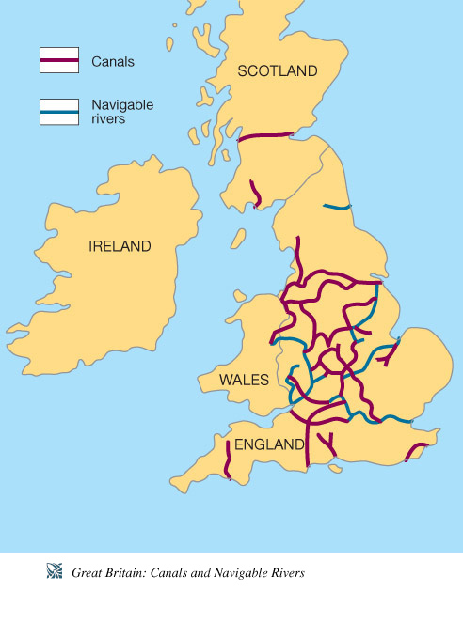
Why did Industrialization begin in England?
Contributing Factors:
Agricultural revolution:
Population growth (labor supply)
Supply of capital to invest & entrepreneurs seeking profits; highly developed banking system
Rich in natural resources,
Government’s “laissez-faire” attitude towards econ. and social regulation; politically stable
Large Empire provided a market for goods & a source of raw materials

Slide 5
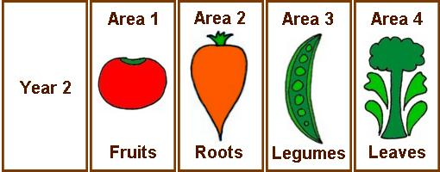
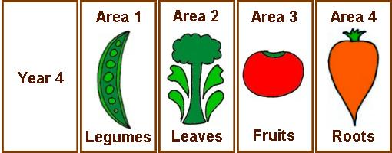
Agricultural Revolution
Year Sheep (lbs) Cattle (lbs)
1710 28 370
1795 80 800
1. Enclosure movement:
2. Methods such as crop rotation and selective breeding were employed by the scientific farmers.
Y2
Y4
Jethro Tull was one of the first scientific farmers.

Slide 6
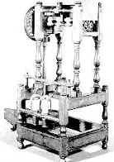
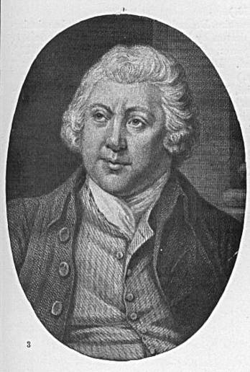
Proto-Industrial Changes in Cotton Production: the Textile Industry From Cottage Industries Machine Work
Industrialization began in textile industry; specifically the demand for cotton
One invention led to another as spinners and weavers tried to keep up with demand for cotton cloth:
Flying shuttle (1733)
Spinning Jenny (1764)
Water frame (1769)
Spinning mule (1779)
Hargreaves’
Spinning
Jenny
1764:
Arkwright invented the
Waterframe in 1769.

Slide 7
The steam engine & coal
The Cotton Gin: Eli Whitney 1793
Thomas Savory and Thomas Newcomen developed steam pump to remove water from mines
JAMES WATT’S (1769) steam engine
Development of heavy industry
Henry Cort: 1780s – “puddling” refined iron for building and industrial grade wrought iron and steel

Slide 8
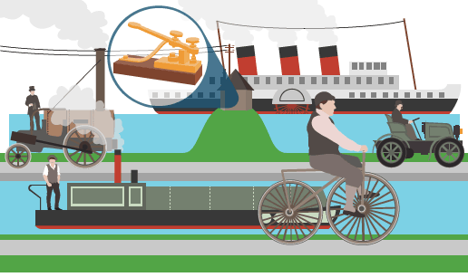
The Transportation Revolution
Effects of the RR
Spurred industrial growth by giving manufacturers a cheap way to transport goods & raw materials
Created new jobs for RR workers, construction, and miners
Boosted agricultural and fishing industries
Increased travel both for pleasure and allowed people to take distant jobs
In 1804, the 1st steam-powered locomotive ran on an industrial rail line. “The Iron Horse” or “The Rocket”
Robert Fulton’s Steamboat (1807)
provided fast, easy transportation
of both raw materials and finished
goods.

Slide 9
By 1850, Britain leads industrial growth
Crystal Palace, 1851
2/3 world’s coal
½ world’s iron
> ½ world’s cotton cloth
1801-1850:
GNP rose 350%
Per capita income rose 100%
International exhibit to showcase Britain’s industrial, economic, and military superiority

Slide 10
Industrialization Spreads after 1815: Continental Europe & US

Slide 11
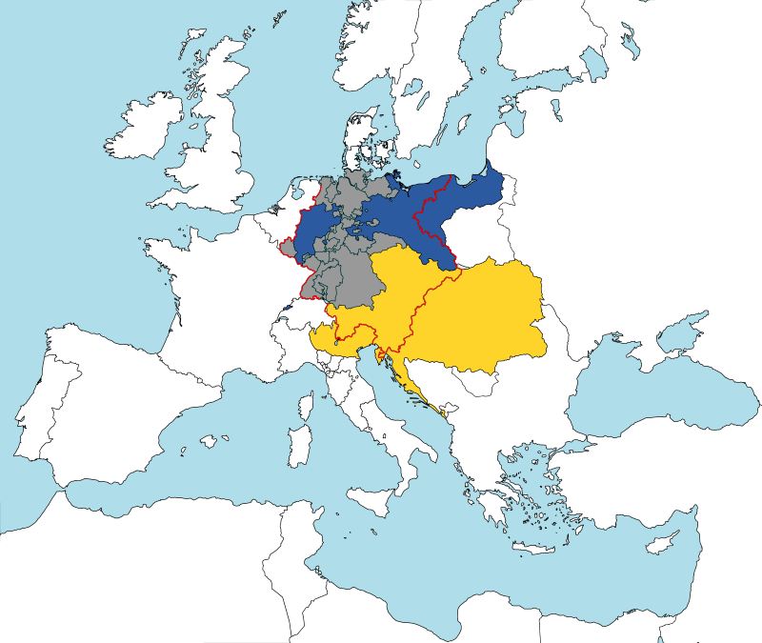
British Monopoly on Industrialization
Up until 1825 it was illegal for engineers, mechanics, and toolmakers to leave England
Until 1843, export of textile machines and equipment illegal
Many emigrated illegally
Tariffs: used to protect domestic industry
France imposed tariffs on British goods
1834: Zollverein – German tariff policy established free trade zone among member states and a uniform tariff on foreign goods
German Zollverein, 1834–1919 Blue: Prussia in 1834 Grey: Areas included until 1866 Yellow: Austrian possessions outside the Zollverein Red: Borders of the 1828 German Confederation (wikipedia)

Slide 12
Rise of Global Inequality
First nations to industrialize (Western Europe, the United States, Japan) became wealthy, powerful nations
Industrialization leads to Imperialism:
Widened gap b/w industrialized and non-industrialized countries
Required steady supply of raw materials
Exploitation of overseas colonies for Markets and Materials

Slide 13
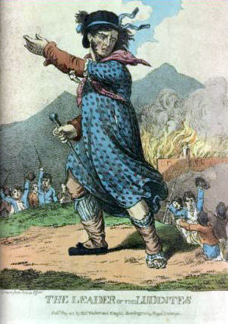
III. Social Impact of Industrialization: New Social Order
Rise of the Middle Class “bourgeoisie”
Ind. Rev. created wealth for factory owners, shippers, merchants, bankers changing the social structure
Upper middle class did not become social equals of aristocrats until late 19th C. (gov. workers, doctors, lawyers, managers, entrepreneurs)
Lower middle class “petite bourgeoisie” had comfortable standard of living (factory overseers, skilled workers, drafters, printers)
Working poor “proletariat”: low standard of living
As machines replaced workers, created anger
Luddites: smashed machines, attacked factories, riots
Union Movement & government response

Slide 14
Urbanization
After 1800, change from rural to urban as people moved from country to find work in the cities in factories & mines
Most city pop. doubled, or even tripled
Rapid, unplanned pop. growth leads to social problems:
No planning for housing, sanitation, ed., police protection, building codes
Lack of sanitation & overcrowding led to disease:
Cholera epidemics
Shorter life spans
Poor lived in filthy, one-room homes while upper middle class lived in suburban areas
Growing gap b/w rich and poor
Poorhouses (Poor Laws)
Irish Potato Famine (1845-46, 1848-51)

Slide 15
Government Intervention & Regulation
1819: 1st Factory Act passed by British gov. to restrict working age & hours
1833: 2nd Factory Act passed by Parliament to further regulate child labor:
Illegal to hire under 9; 9-12: 8 hrs., 13-17: 12 hrs., by 1847: 10 hrs. Act
1842: Mines Act
Regulate child labor in coal mines
Prevented women & children from working underground
1847: Ten Hours Act

Slide 16
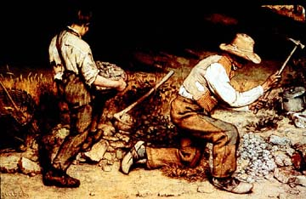
Realism, mid-19th Century
Industrialization and urbanization spread from England to the U.S. and the Continent of Europe in the 19th Century.
Western cities grew dramatically due to migration from rural areas due to new job opportunities, as well as improving health and living conditions.
Scientific advances led to industrial growth.
Charles Darwin’s theory of natural selection promoted an interest in science and challenged traditional Christian beliefs, which led to the rise of secularism.
Darwin’s theory was applied to socioeconomics in that those that industrialized became the most economically “fit” companies and countries. This was used to justify Western racism, imperialism, nationalism, and militarism going into the early 20th Century.
Industrialization & Social Darwinism were the justification for the colonization by Western nations of peoples they believed were inferior to them on a social and national hierarchy.
Edouard Manet, Olympia, 1863, Musee d’Orsay, Paris.
Gustave Courbet, The Stone Breakers, 1849, Dresden.

Slide 17
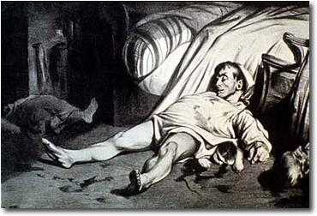
Karl Marx & Class Struggle
Marx believed those that controlled the means of production did so at the expense of the exploitation of the laborer. (Haves vs. Have-nots)
He hoped to create a socialist state in which the workers would seize power and destroy capitalism.
His theory of class struggle appealed to the oppressed and led to the rise of trade unions and socialist groups.
Jean-Francois Millet, The Gleaners, 1857, Louvre, Paris.
Honore Daumier, Rue Transnonain, 1834, lithograph, Philadelphia.

Slide 18
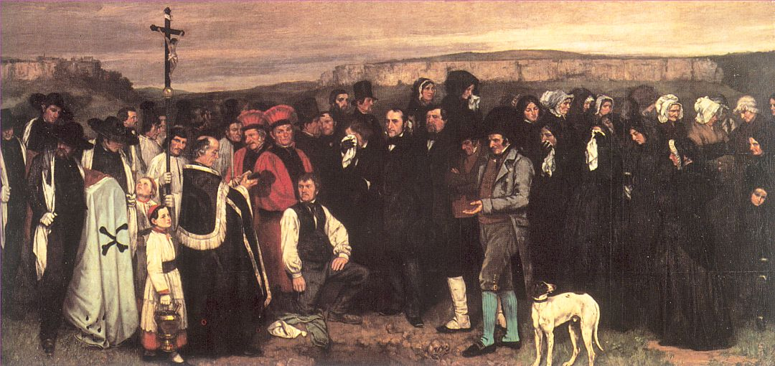
Paintings of Modern Life
Realism is considered the first modernist movement.
Artists and writers of the realist movement were reevaluating “reality” and focused on only what they could see and experience on a daily basis.
They did not paint fictional subjects because they were not real nor visible in the present world.
Realists portrayed scenes that were not considered worthy prior to this period. Scenes of laborers, peasants, and daily life.
Gustave Courbet, Burial at Ornans, 1849, Louvre, Paris.
Honore Daumier, The Third Class Carriage, 1862, The Met, NY.

Slide 19
Romanticism, 18th-19th Centuries: “Trust your heart rather than your head.”
Reaction against neoclassicism’s emphasis on reason and order; inspired by Rousseau’s Social Contract: “Man is born free, yet everywhere he is in chains!”
Emphasis on emotion in art, individual liberty, ending social injustices, and achieving democracy; the path to freedom was through imagination and feeling (rather than reason and thinking)
Romantic artists to know: Delacroix, Goya, Gericault, Turner
Goya, Saturn Devouring One of His Children, 1819-1823, Prado, Madrid, Spain.
“I am like no one in the whole world. I may be no better, at least I am different.” -Rousseu
Franciso de Goya, The Family of Charles IV, 1800, Prado, Madrid, Spain.

Slide 20
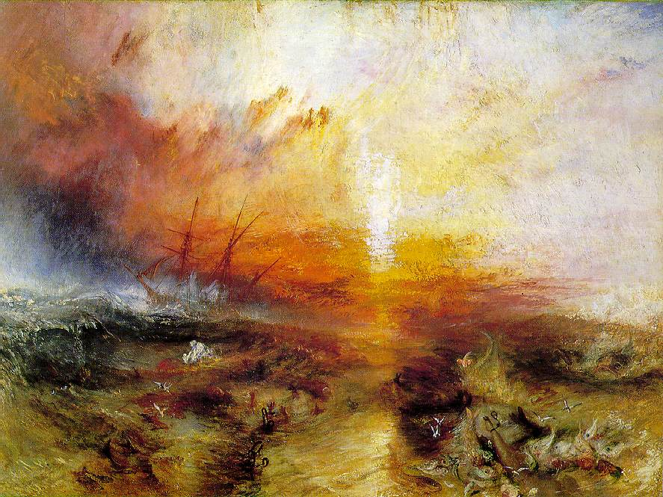
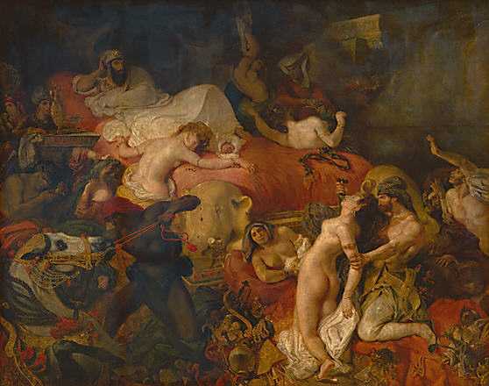
Delacroix, Liberty Leading the People, 1830, Louvre, Paris.
Gericault, Raft of the Medusa, 1818-1819, Louvre, Paris.
Delacroix, Death of Sardanapalus, 1826, Louvre, Paris.
Turner, The Slave Ship, 1840, Boston, MA.

Slide 21
Liberalism in the 19th Century
19th C. Conservatism
Classical Liberalism: “that government is best which governs least”
Government that protects liberty of the people from others and itself
Thomas Paine, Common Sense
Natural rights
Social Contract Theory
Rousseau’s “general will”
Locke
Protection of property rights
Anticlerical, anti-aristocratic
Coupled with economic theory: free market capitalism (Adam Smith)
Free trade: John Stuart Mill, David Ricardo
Utilitarianism: Jeremy Bentham, Mill
Reaction to liberalism and excesses of the French Revolution
Edmund Burke
Joseph de Maistre
Metternich: failure to suppress liberalism and nationalism long-term (Revolutions of 1848)
Supported by Church, Royalists, peasants
Continuity and stability of institutions that have evolved gradually over time

Slide 22
Liberalism vs. Conservatism
Liberalism:
Left Wing
Reform/Change society acc. to ideals of Enlightenment and French Rev.
Middle class
Emphasis on individual freedom
Individual growth
Separation of state and church
Limited monarchy
Conservatism:
Right Wing
Strengthen traditional society
Upper class
Emphasis on community
Preserve Social hierarchy
Established church
Supported status quo
Legitimate institutions
Similarities below
Rejection of radicalism and violence, recognized need for limits on the powers of government, advocacy of balance in society regarding individual rights and societal powers –not so similar if analyzed further

Slide 23
Revolutions 1820-1831
Greek Revolt (1821): independent 1830
Decembrist Revolt (1825)
Paris, 1830: 3 Glorious Days
Charles X abdicates in favor of Louis-Philippe “July Monarchy” and House of Orleans (overthrown in 1848)
Belgium, 1830
Independence from Dutch
Poland, 1830

Slide 24
REVOLUTIONS OF 1848 “THE SPRINGTIME OF PEOPLES” UNIFICATION OF ITALY AND GERMANY

Slide 25
Causes of the Revolutions of 1848
The Hungry 40’s
Crop failure
High prices
Unemployment
Potato blight
Increase in crime
Radicalization of politics
Abdication of Louis-Philippe, 1848 and the rise of the 2nd Republic under Louis Napoleon
Revolts across Europe calling for constitutionalism, liberalism, rights – free expression, including press
Britain and Russia exceptions

Slide 26
Revolutions of 1848

Slide 27
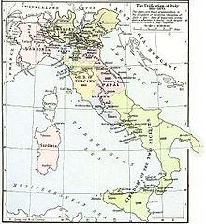
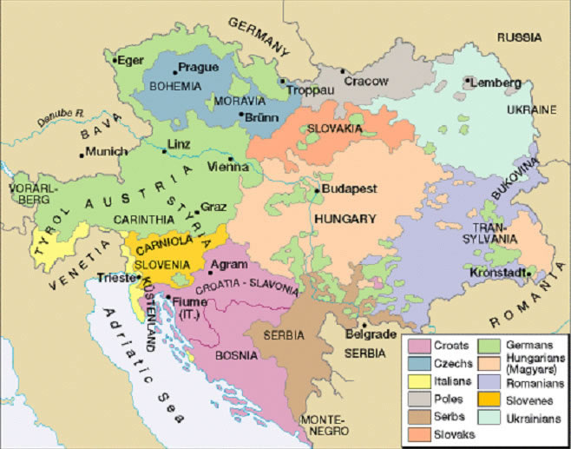
“When France sneezes, Europe catches cold” –Metternich
Italy
Austria
Giuseppe Mazzini (nationalist Giuseppe Garibaldi
Italian states desire freedom from foreign rule
Put down by Catholic alliance of France and Austria
Multi-ethnic, susceptible to revolt
Forced Metternich out, new Emperor, Franz Joseph I grants a new constitution
Gain peasant support by abolishing feudalism
Hungarian Magyars demand autonomy
Revolution suppressed not due to strength of Hapsburgs, but division of revolutionaries
Hapsburgs agreed to Ausgleich – nearly co-equal status to King of Hungary

Slide 28
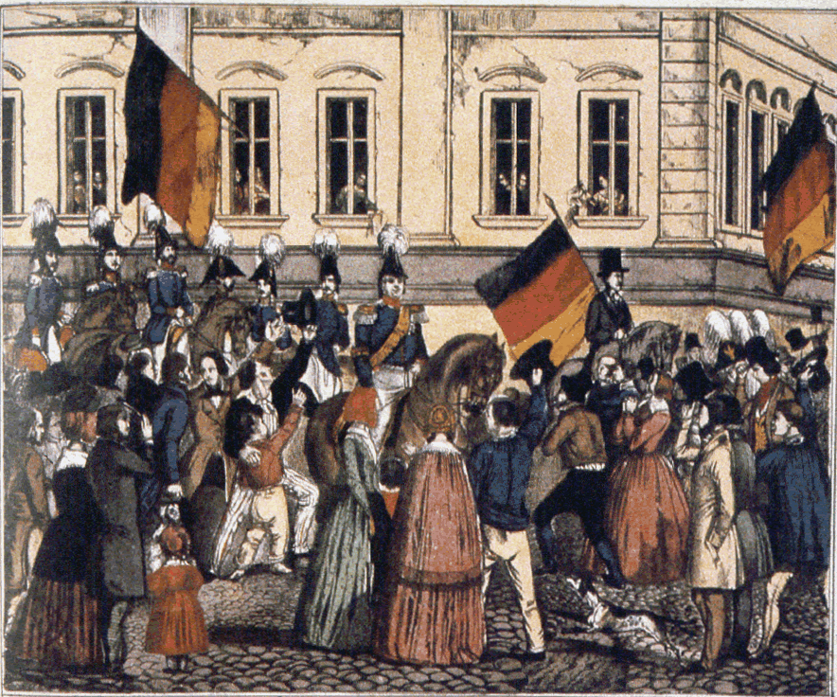
Germany
“To My People and to the German Nation”
Pan-Germanism: unify German speaking countries of Europe
Prussian King Frederick William IV convenes Frankfurt Parliament
Constitutional monarchy
Rejected constitution and without Prussia, constituent assembly dissolved

Slide 29
The Crimean War, 1853-1856
Ottoman (the “sick man of Europe”) allied with France, Britain, and Sardinia to defeat Russian expansionism
Battle of Balaklava, Charge of the Light Brigade, 1854
Alfred Lord Tennyson
Florence Nightingale
Peace of Paris, 1856
Russia out of the Black Sea
Determined to restructure militarily and industrially
Expands east
Laid foundation for Italian and German unification

Slide 30
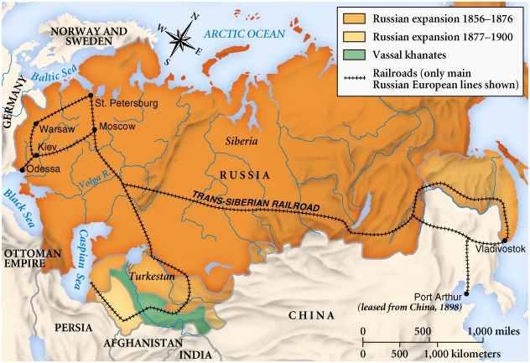

Slide 31
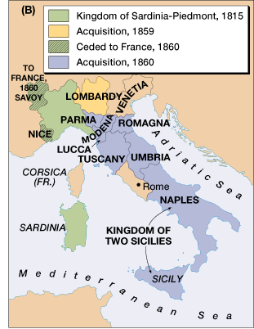
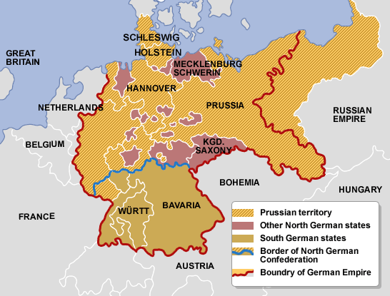
Unification of Italy and Germany
Germany, 1871
Bismarck’s real-politik
Zollverein
Kleindeutschland vs. Grossdeutschland
1862 Danish War
1866 Austro-Prussian War
North German Confederation
1870 Franco-Prussian War
Italy, 1870
Risorgimento
Prime Minister Camillo di Cavour, Kingdom of Piedmont-Sardinia
Defeated Austria with French help in Franco-Austrian War 1859
Garibaldi brought the southern part of the peninsula
Unified most of Italy by 1861
Venice, 1866 (Austro-Prussian War)
Rome, 1870 (Franco-Prussian War)

